Slide 1
BE 1600 Introduction to Programming and Computation Fall Term 2023 Exam 01 10/11/2023

Slide 2
Exam Instructions
Date: Wednesday 10/11/2023
Time: Class time
Location: Science Hall | Room 1117
Exam duration: total 50 minutes
Please, arrive 10 minutes before the exam begins.
There will be No make-up Exam (NO EXCEPTION)

Slide 3
Exam Instructions
The exam is Closed Book/Closed Notes.
You can use one cheat sheets (81/2 x 14), typed or handwritten. Submit your cheat sheet with your exam copy. Do not write your name on the cheat sheet.
No electronic devices may be used during the examination, i.e. no calculator, cell phones, mp3 players, laptops, etc.
Make sure you complete the requested information at the top of the exam.
Make sure you have your picture ID; We may ask you to show your picture ID during the exam and confirm your name.

Slide 4
Exam Instructions
There will be 40 Multiple-Choice Questions (200 points)
Answer each multiple-choice question by selecting the correct response. You should choose the single best alternative for each multiple-choice question, even if you believe that a question is ambiguous or contains a typographic error. Provide only one answer.
When completing the exam, please leave the room and be courteous to those still taking the exam.

Slide 5
What to Study?
Four chapters
Chapter 1: Introduction to Computers and Programming
Chapter 2: Input, Processing, and Output
Chapter 3: Decision Structures and Boolean Logic
Chapter 4: Repetition Structures

Slide 6
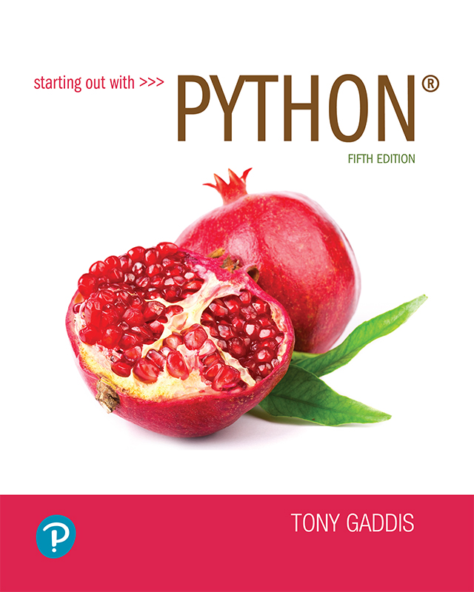
Starting out with Python
Fifth Edition
Chapter 1
Introduction to Computers and Programming
Copyright © 2021, 2018, 2015 Pearson Education, Inc. All Rights Reserved

Slide 7
How Computers Store Data
All data in a computer is stored in sequences of 0s and 1s
Bit represents two values, 0 and 1
Bit: electrical component that can hold positive or negative charge, like on/off switch
Byte: just enough memory to store letter or small number

Slide 8
Storing Characters
Data stored in computer must be stored as binary number
Characters are converted to numeric code, numeric code stored in memory
Most important coding scheme is ASCII
ASCII is limited: defines codes for only 128 characters
Unicode coding scheme becoming standard
Compatible with ASCII
Can represent characters for other languages

Slide 9
Compilers
Programs written in Python (high-level languages) must be translated into machine (binary) language to be executed
Compiler: translates high-level language program into separate machine language program
Machine language program can be executed at any time

Slide 10
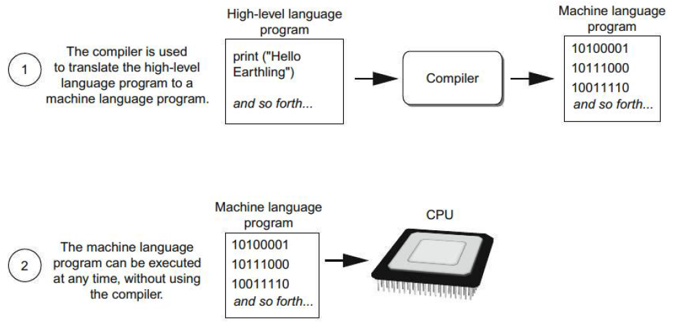

Slide 11
Interpreters
Interpreter: translates and executes instructions in high-level language program
Used by Python language
Interprets one instruction at a time
No separate machine language program

Slide 12
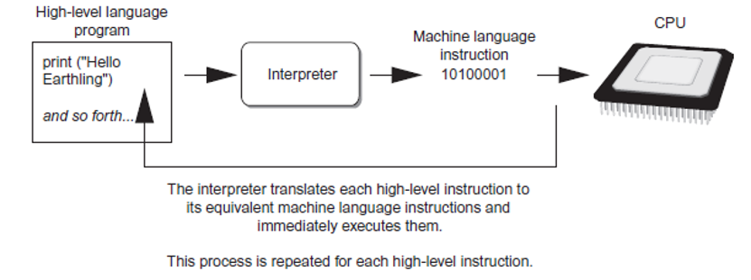
Compilers and Interpreters
Figure 1-19 Executing a high-level program with an interpreter
Notes:
The process is as follows. The high level program reads as follows. print left parenthesis double quote hello Earthling double quote right parenthesis, and so forth. This program is sent to the interpreter. The interpreter converts the program to machine language instruction 1 0 1 0 0 0 0 1 and it is executed by central processing unit. The interpreter translates each high level instruction to its equivalent machine language instructions then immediately executes them. This process is repeated for each high level instruction.

Slide 13
Starting out with Python
Fifth Edition
Chapter 2
Input, Processing, and Output
Copyright © 2021, 2018, 2015 Pearson Education, Inc. All Rights Reserved

Slide 14
Displaying Output with the print Function
print function: displays output on the screen
>>> print('Hello world')
Hello world
>>>

Slide 15
Strings and String Literals
String: sequence of characters that is used as data
String literal: string that appears in actual code of a program
Must be enclosed in single (') or double (") quote marks
String literal can be enclosed in triple quotes (''' or """)
Enclosed string can contain both single and double quotes and can have multiple lines

Slide 16
Comments
Comments: notes of explanation within a program
Ignored by Python interpreter
Intended for a person reading the program’s code
Begin with a # character
End-line comment: appears at the end of a line of code
Typically explains the purpose of that line

Slide 17
Variables
Variable: name that represents a value stored in the computer memory
Used to access and manipulate data stored in memory
A variable references the value it represents
Assignment statement: used to create a variable and make it reference data
General format is variable = expression
Example: age = 29
Assignment operator: the equal sign (=)

Slide 18
Variable Naming Rules
Rules for naming variables in Python:
Variable name cannot be a Python key word
Variable name cannot contain spaces
First character must be a letter or an underscore
After first character may use letters, digits, or underscores
Variable names are case sensitive
Variable name should reflect its use

Slide 19
Python key Words
and | del | from | not | while
as | elif | global | or | with
assert | else | if | pass | yield
break | except | import | print
class | exec | in | raise
continue | finally | is | return
def | for | lambda | try

Slide 20
Numeric Data Types, Literals, and the str Data Type
Data types: categorize value in memory
e.g., int for integer, float for real number, str used for storing strings in memory
Numeric literal: number written in a program
No decimal point considered int, otherwise, considered float
Some operations behave differently depending on data type

Slide 21
Reading Input from the Keyboard
Most programs need to read input from the user
Built-in input function displays a prompt and reads input from keyboard
Returns the data as a string
Format: variable = input(prompt)
prompt is typically a string instructing user to enter a value
Does not automatically display a space after the prompt

Slide 22
Reading Numbers with the input Function
input function always returns a string
Built-in functions convert between data types
int(item) converts item to an int
float(item) converts item to a float
Nested function call: general format: function1(function2(argument))
value returned by function2 is passed to function1
Type conversion only works if item is valid numeric value, otherwise, causes an error

Slide 23
Performing Calculations
Operators
Symbol | Operation | Description
+ | Addition | Adds two numbers
− | Subtraction | Subtracts one number from another
* | Multiplication | Multiplies one number by another
/ | Division | Divides one number by another and gives the result as a floating-point number
// | Integer Division | Divides one number by another and gives the result as a whole number
% | Remainder | Divides one number by another and gives the remainder
** | Exponent | Raises a number to a power

Slide 24
Operator Precedence and Grouping with Parentheses
Python operator precedence:
Operations enclosed in parentheses
Forces operations to be performed before others
Exponentiation (**)
Multiplication (*), division (/ and //), and remainder (%)
Addition (+) and subtraction (-)
Higher precedence performed first
Same precedence operators execute from left to right

Slide 25
Mixed-Type Expressions and Data Type Conversion
Data type resulting from math operation depends on data types of operands
Two int values: result is an int
Two float values: result is a float
int and float: int temporarily converted to float, result of the operation is a float
Mixed-type expression
Type conversion of float to int causes truncation of fractional part

Slide 26
String Concatenation
To append one string to the end of another string
Use the + operator to concatenate strings
>>> message = 'Hello ' + 'world'
>>> print(message)
Hello world
>>>

Slide 27
String Concatenation
You can use string concatenation to break up a long string literal
print('Enter the amount of ' +
'sales for each day and ' +
'press Enter.')
This statement will display the following:
Enter the amount of sales for each day and press Enter.

Slide 28
More About The print Function
print function displays line of output
Newline character at end of printed data
Special argument end='delimiter' causes print to place delimiter at end of data instead of newline character
print function uses space as item separator
Special argument sep='delimiter' causes print to use delimiter as item separator

Slide 29
More About The print Function
Special characters appearing in string literal
Preceded by backslash (\)
Examples: newline (\n), horizontal tab (\t)
Treated as commands embedded in string

Slide 30
Displaying Formatted Output with F-strings
Format specifiers can be used with placeholders
.2f means:
round the value to 2 decimal places
display the value as a floating-point number
>> num = 123.456789
>> print(f'{num:.2f}')
123.46
>>>

Slide 31
Displaying Formatted Output with F-strings
Other examples:
>> num = 123456789
>> print(f'{num:,d}')
123,456,789
>>> num = 12345.6789
>>> print(f'{num:.2e}')
1.23e+04

Slide 32
Displaying Formatted Output with F-strings
Specifying a minimum field width:
>>> num = 12345.6789
>>> print(f'The number is {num:12,.2f}')
The number is 12,345.68
Field width = 12
The number is 12,345.68
Field width = 12

Slide 33
Displaying Formatted Output with F-strings
Aligning values within a field
Use < for left alignment
Use > for right alignment
Use ^ for center alignment
Examples:
print(f'{num:<20.2f}')
print(f'{num:>20.2f}')
print(f'{num:^20.2f}')

Slide 34
Displaying Formatted Output with F-strings
The order of designators in a format specifier
When using multiple designators in a format specifier, write them in this order:
[alignment][width][,][.precision][type]

Slide 35
Named Constants
You should use named constants instead of magic numbers.
A named constant is a name that represents a value that does not change during the program's execution.
Example: INTEREST_RATE = 0.069
This creates a named constant named INTEREST_RATE, assigned the value 0.069. It can be used instead of the magic number: amount = balance * INTEREST_RATE

Slide 36
Starting out with Python
Fifth Edition
Chapter 3
Decision Structures and Boolean Logic
Copyright © 2021, 2018, 2015 Pearson Education, Inc. All Rights Reserved

Slide 37
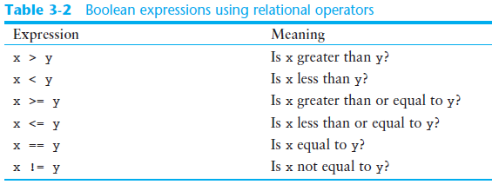
Boolean Expressions and Relational Operators

Slide 38
Single-Line if Statements
An if statement can be written on a single line if it executes only one statement.
Python syntax:
if condition: statement
Example:
if score > 59: print('You passed!')

Slide 39
The if-else Statement
Dual alternative decision structure: two possible paths of execution
One is taken if the condition is true, and the other if the condition is false
Syntax: if condition:
statements
else:
other statements
if clause and else clause must be aligned
Statements must be consistently indented

Slide 40
The if-elif-else Statement
if-elif-else statement: special version of a decision structure
Makes logic of nested decision structures simpler to write
Can include multiple elif statements
Syntax:
if condition_1:
statement(s)
elif condition_2:
statement(s)
elif condition_3:
statement(s)
else
statement(s)
Insert as many elif clauses
as necessary.

Slide 41
Comparing Strings
Strings can be compared using the == and != operators
String comparisons are case sensitive
Strings can be compared using >, <, >=, and <=
Compared character by character based on the ASCII values for each character
If shorter word is substring of longer word, longer word is greater than shorter word

Slide 42
Logical Operators
Logical operators: operators that can be used to create complex Boolean expressions
and operator and or operator: binary operators, connect two Boolean expressions into a compound Boolean expression
not operator: unary operator, reverses the truth of its Boolean operand

Slide 43
The and Operator
Takes two Boolean expressions as operands
Creates compound Boolean expression that is true only when both sub expressions are true
Can be used to simplify nested decision structures
Truth table for
the and operator
Value of the Expression | Expression
false | false and false
false | false and true
false | true and false
true | true and true

Slide 44
The or Operator
Takes two Boolean expressions as operands
Creates compound Boolean expression that is true when either of the sub expressions is true
Can be used to simplify nested decision structures
Truth table for
the or operator
Value of the Expression | Expression
false | false and false
true | false and true
true | true and false
true | true and true

Slide 45
The not Operator
Takes one Boolean expressions as operand and reverses its logical value
Sometimes it may be necessary to place parentheses around an expression to clarify to what you are applying the not operator
Truth table for the not operator
Value of the Expression | Expression
false | true
true | false

Slide 46
Operator Precedence
**
not
*, /, //, %
+, -
<, <=, >, >=
==, !=
and
or
=

Slide 47
Starting out with Python
Fifth Edition
Chapter 4
Repetition Structures
Copyright © 2021, 2018, 2015 Pearson Education, Inc. All Rights Reserved

Slide 48
Condition-Controlled and Count-Controlled Loops
There are two broad categories of loops:
Condition-controlled
uses a true/false condition to control the number of times the loop iterates
Count-controlled
repeats a specific number of times

Slide 49
The while Loop: a Condition-Controlled Loop
while loop: while condition is true, do something
Two parts:
Condition tested for true or false value
Statements repeated as long as condition is true
General format:
while condition:
statements

Slide 50
Using the while Loop as a Count-Controlled Loop
Example
Initialization: The variable n is initialized with 0
Comparison: The loop iterates as long as n is less than 5
Update: 1 is added to n
Initialization
n = 0
while n < 5:
print(f'Inside the loop, the value of n is {n}.')
n += 1
Comparison
Update

Slide 51
Infinite Loops
Loops must contain within themselves a way to terminate
Something inside a while loop must eventually make the condition false
Infinite loop: loop that does not have a way of stopping
Repeats until program is interrupted
Occurs when programmer forgets to include stopping code in the loop

Slide 52
The for Loop: a Count-Controlled Loop
Initialization
n = 1
while n <= 5:
print(n)
n += 1
Comparison
Update
for n in range(starting value, ending limit, step value):
# Loop body
for n in range(1, 6, 1):
print (n)

Slide 53
Using the range Function with the for Loop
The range function simplifies the process of writing a for loop
range returns an iterable object
Iterable: contains a sequence of values that can be iterated over
range characteristics:
One argument: used as ending limit
Two arguments: starting value and ending limit
Three arguments: third argument is step value

Slide 54
Calculating a Running Total
Programs often need to calculate a total of a series of numbers
Typically include two elements:
A loop that reads each number in series
An accumulator variable
Known as program that keeps a running total: accumulates total and reads in series
At end of loop, accumulator will reference the total

Slide 55

Product of Series
Write a program to calculate the product of the following series:
n = 100
num = 1
den = 5
sum = 1
for i in range(100):
sum = sum * (num/den)
den += 4
print(sum)
1.9082769478055523e-219

Slide 56

Sum of Series
Write a program to calculate the sum of the following series:
n = 100
num = 1
den = 1
sum = 0
for i in range(100):
sum = sum + (num/den)
den += 1
print(sum)
5.187377517639621

Slide 57
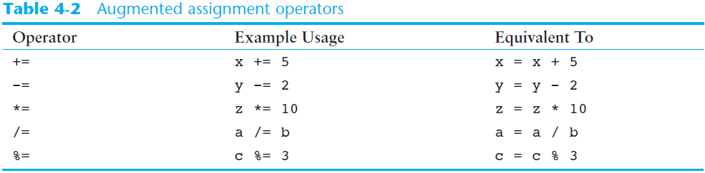
The Augmented Assignment Operators (cont’d.)

Slide 58
Input Validation Loops
Computer cannot tell the difference between good data and bad data
If user provides bad input, program will produce bad output
It is important to design program such that bad input is never accepted

Slide 59
Nested Loops
A loop that is inside another loop.
Key points about nested loops:
Inner loop goes through all of its iterations for each iteration of outer loop
Total number of iterations in nested loop:
number of iterations of inner loop X number of iterations of outer loop

Slide 60
The break Statement
The break statement causes a loop to terminate
n = 0
while n < 100:
print(n)
if n == 5:
break
n += 1
print(f'The loop stopped and n is {n}.')
This statement causes the loop to stop
Program Output
0
1
2
3
4
5
The loop stopped and n is 5.

Slide 61
The continue Statement
The continue statement causes the current iteration of a loop to end early
Example:
n = 0
while n < 10:
n += 1
if n % 3 == 0:
continue
print(n)
This statement ends the current iteration and causes the loop to skip to the next iteration.
Program Output
1
2
4
5
7
8
10

